Slide 1

Car RENTAL APPLICATION
JCK
CALLUM STEWART
ROAN BRADLEY
MAKS BREZA

Slide 2

WHY ARE WE HERE?
Problem
Cars sit unused while renters overpay.
Opportunity
We connect owners and drivers through a trusted marketplace.

Slide 3


Elevator Pitch
What We Do
Turn unused cars into passive income
How We Do It
We connect car owners and renters through a trusted peer-to-peer marketplace, making transportation affordable and flexible

Slide 4

JCK
Turn Idle Cars into Easy Income
Save Money
Have a trusted site
Enjoy Easy booking
Rent Smart Earn Easier

Slide 5
NOT List
What We Are Not
A traditional car rental company
A car buying/selling platform
A Taxi service

Slide 6

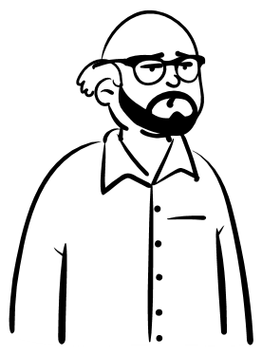


MEET THE NEIGHBOURS
Enablers
Dependencies
Constraints
Amplifiers
STRIPE
•make transactions seamless
•They reduce fraud risk
APPLE APPSTORE
App approval policies
Revenue share (30% in some cases)
(GDPR)
Strict data storage rules
User consent requiremts
INSTAGRAM
User-generated content drives awareness
Influencer marketing
Viral growth potential

Slide 7
SOLUTION
A peer-to-peer car rental marketplace that allows private car owners to list their vehicles and renters to book them instantly through a secure, insured mobile platform
For owners
For Renters
List vehicle (photos,
availability, pricing)
Set rental rules
Approve booking
Getpaid automatically
Search by location/date
Compare cars & prices
Book instantly
Unlock / collect vehicle
Rate experience

Slide 8
WHAT KEEPS US UP AT NIGHT

Slide 9
How big is this project
Implement frontend features
Listing page
Planning / User stories
Design UI / UX
Home page
Saved listings
User profile page
Testing
Implement backend features
Ship it
Testing
User account creation / management
Reccomendations / searching
Reviews
Main rental feature

Slide 10
What's going to give
If things don’t go as planned, we can always reduce scope to maintain quality of the features
Most important thing is to deliver a quality app that accomplishes what we set out to do
What we can compromise on
What we CAN'T compromise on
Testing
User experience
Project scope
Nice to have features
Core features
App quality

Slide 11
What it's going to take
3 people ~10 weeks
Planning / User stories
Design UI / UX
Implement frontend features
Testing
Ship it
Testing
Implement backend features

Slide 12

Q A

